Slide 1
Gem Grab
Credo, Shreeji, Richard

Slide 2
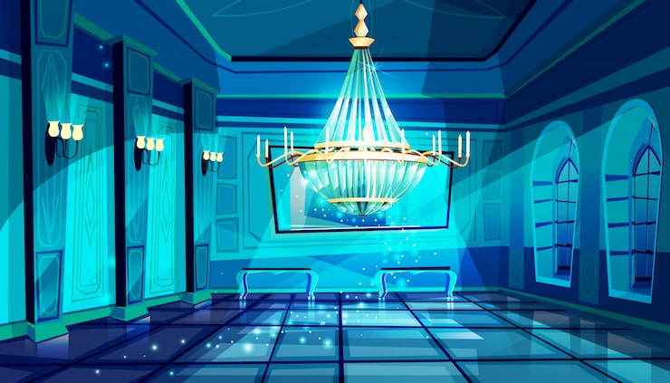
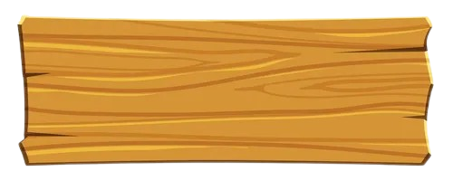

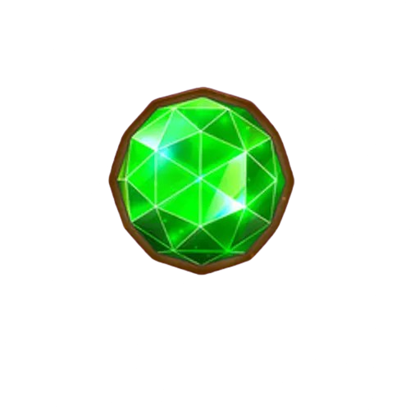



Game Concept
Fast-paced 2D Platformer.
Playing as Cubby, a thief (Main character).
Stealing gems while avoiding traps inside a museum.
Play
Credits
𝙂𝙀𝙈 𝙂𝙍𝘼𝘽
Settings

Slide 3
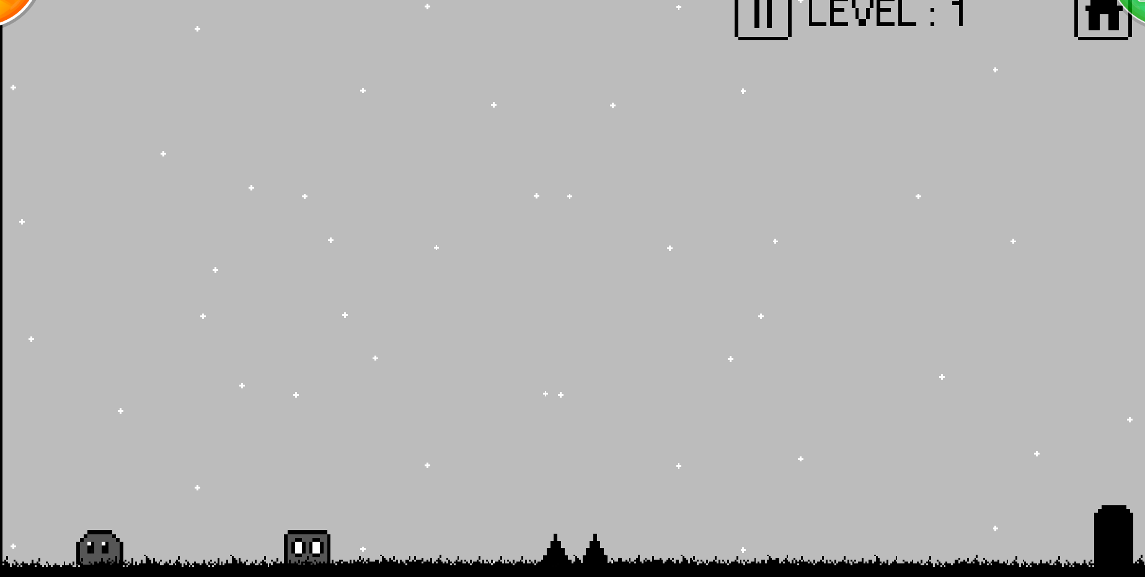
Inspiration
https://www.friv.com/z/games/1930/game.html
1930

Slide 4
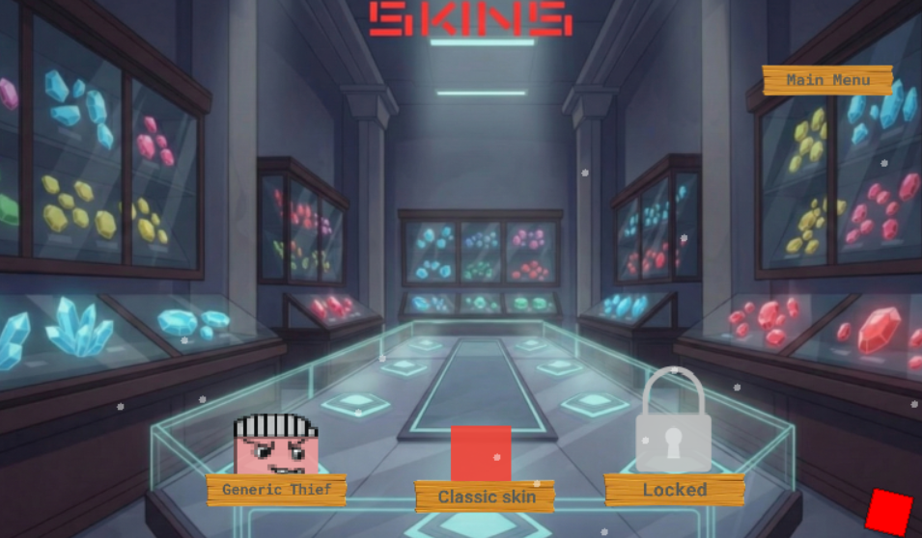
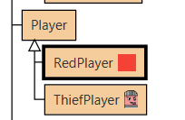
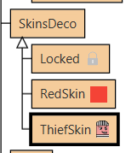
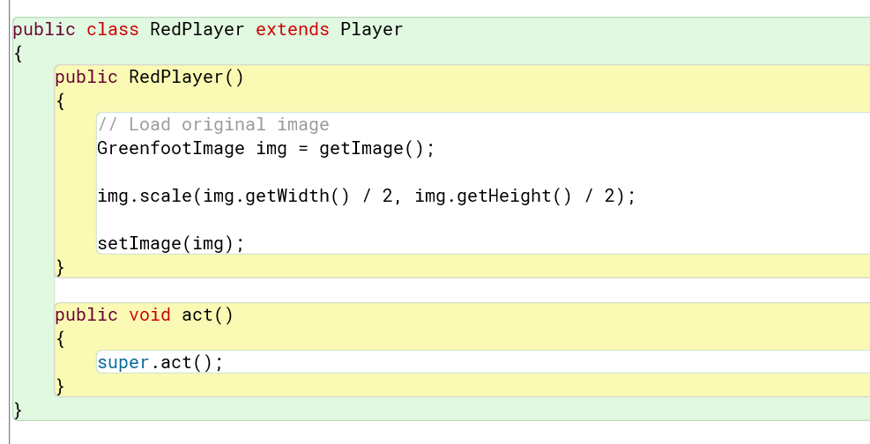
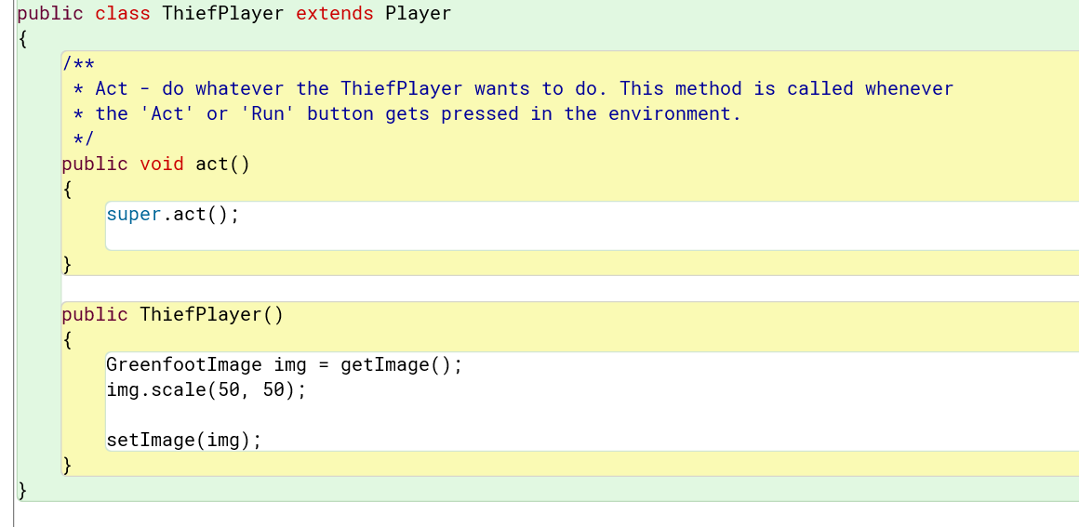
Slide 4 — Characters

Slide 5
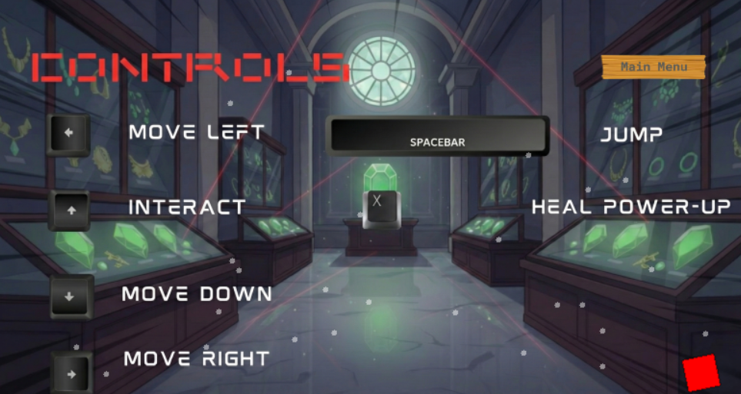
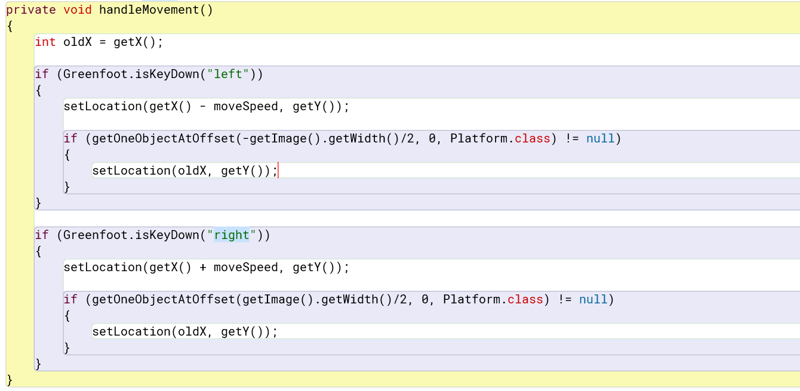
Movement System

Slide 6
Main Features
Jumping and gravity.
Traps that deal damage.
Gem Collection.

Slide 7
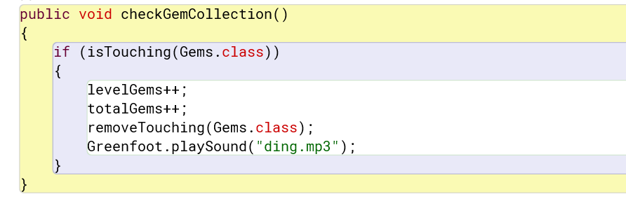
Gem Collection + movements

Slide 8
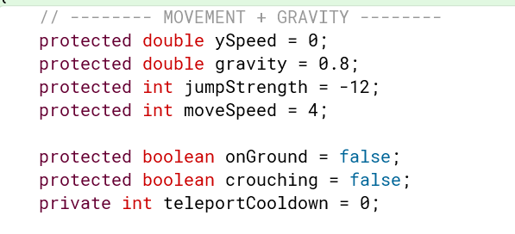
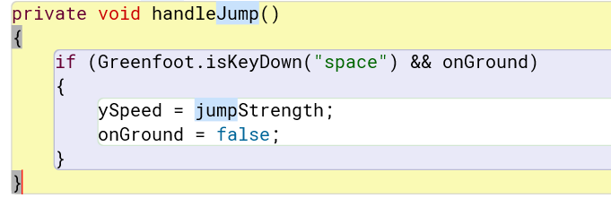
Jumping and gravity

Slide 9
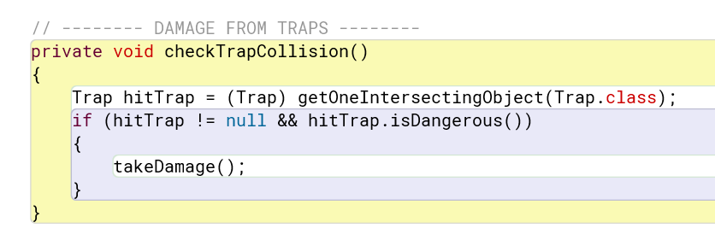
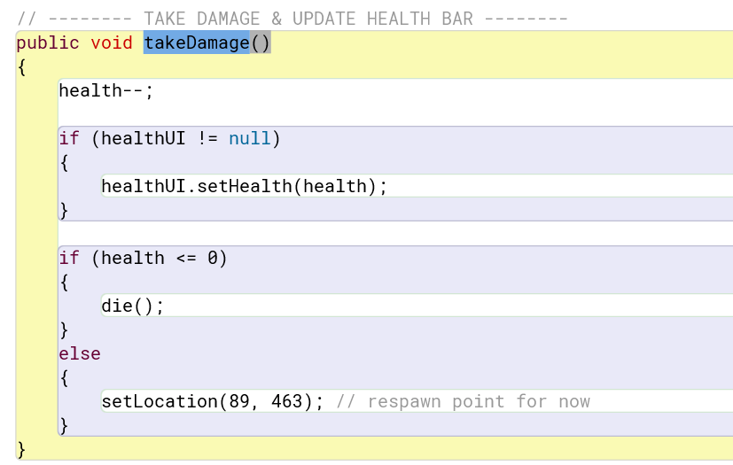
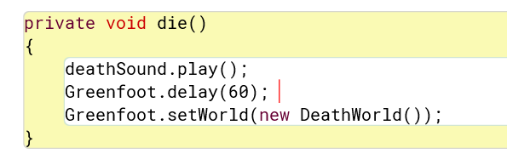
Traps that deal damage.

Slide 10
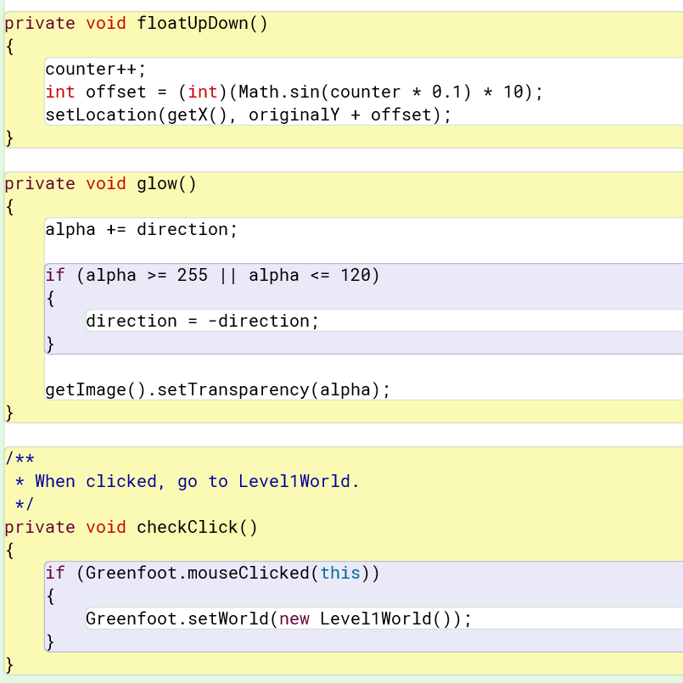
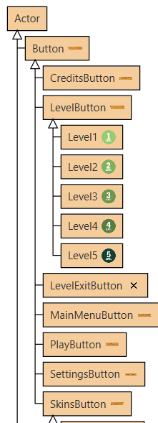
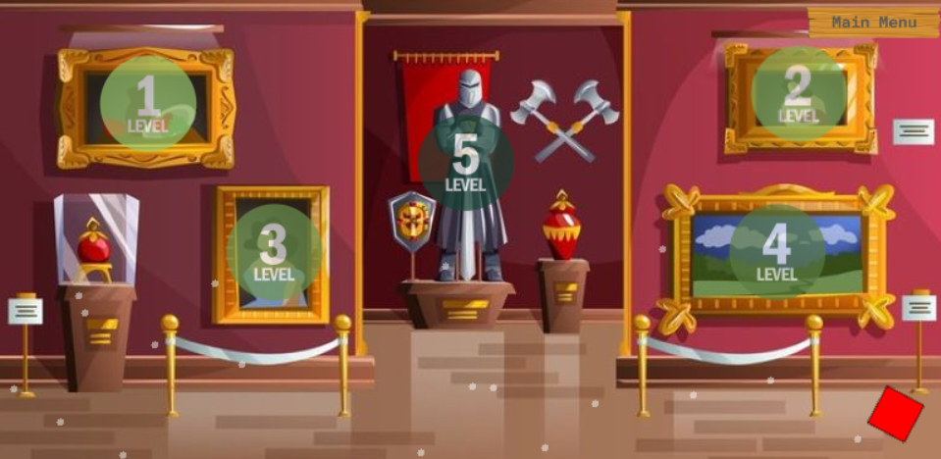
Level designs
5 challenging Levels.

Slide 11
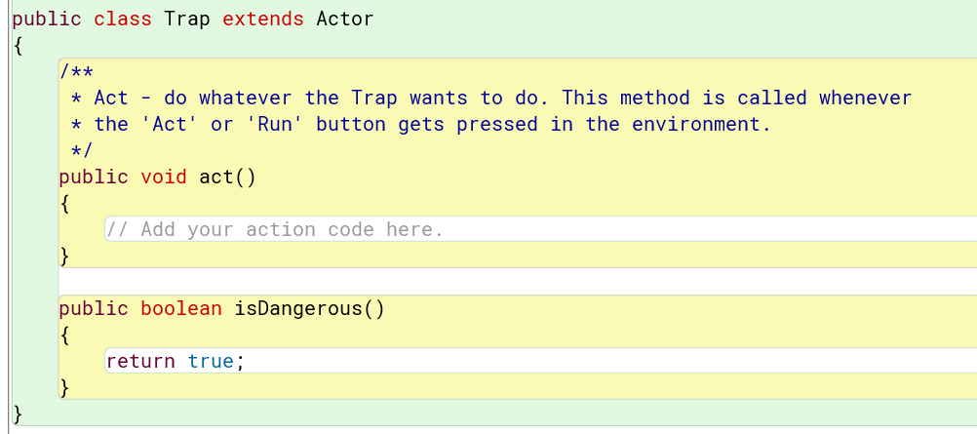
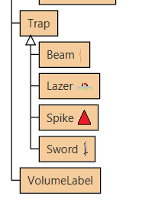
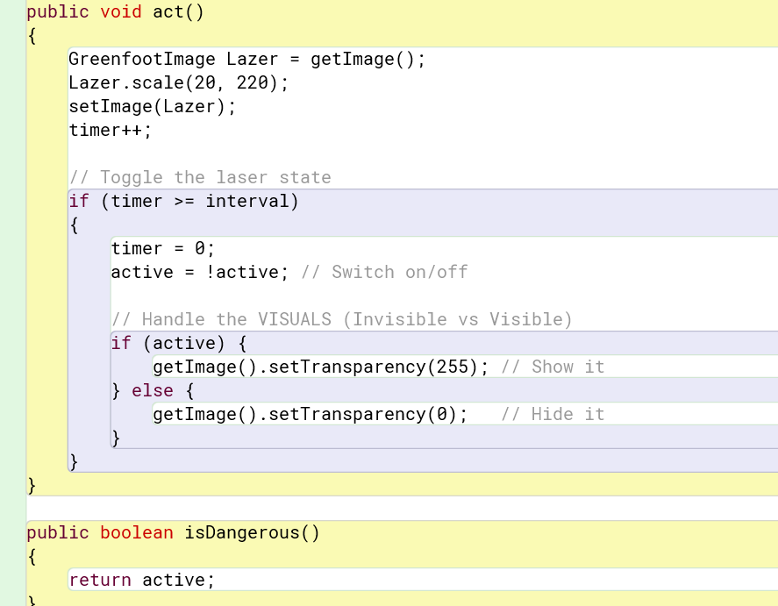
Traps

Slide 12
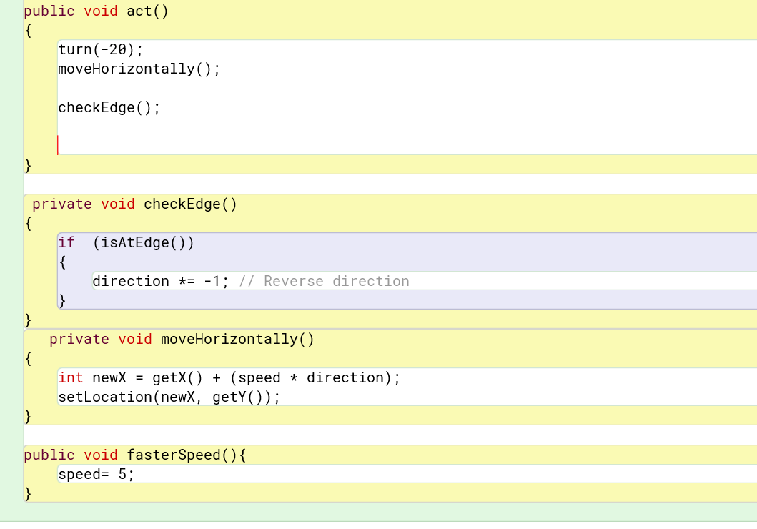
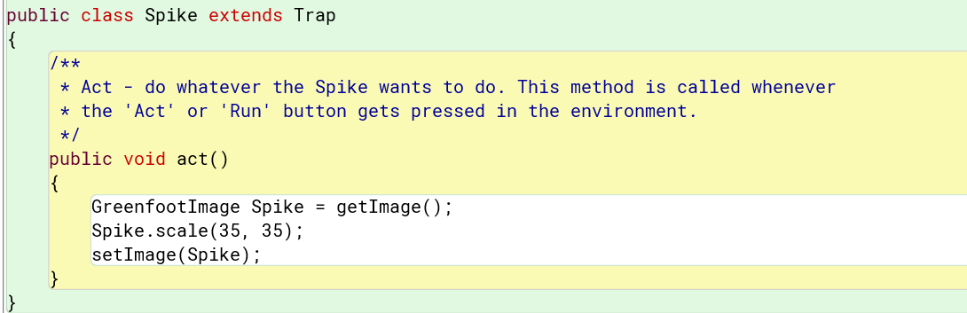
Rotating Sword
Spike

Slide 13
Other features
Animated buttons when hovering over them.
Background effects (Particles).
Able to change in-game music volume.
Skin selector

Slide 14
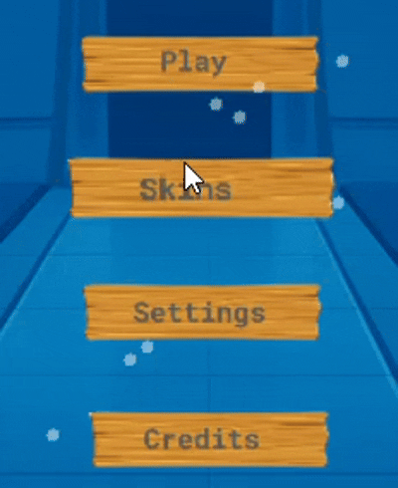
Animated buttons when hovering over them.

Slide 15
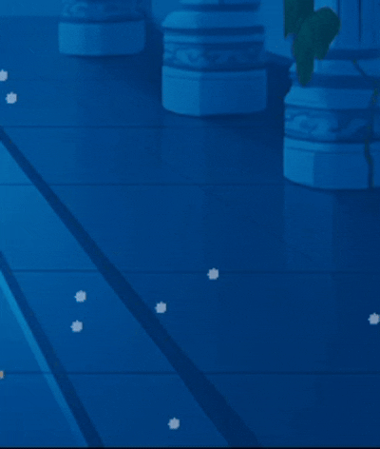
Background effects (Particles).

Slide 16
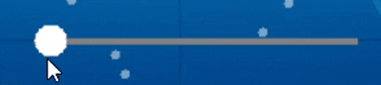
Able to change in-game music volume.

Slide 17
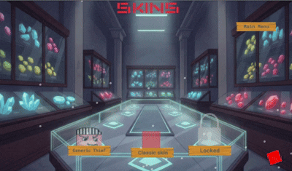
Skin selector

Slide 18
Conclusion

